Slide 1
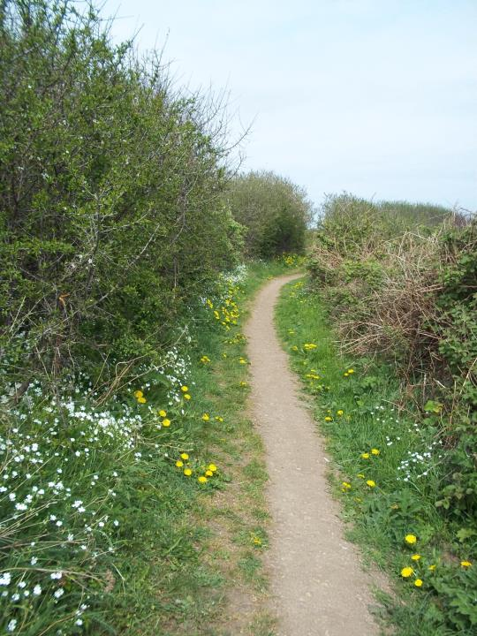
Preparing
the Way
Following Jesus
wherever he leads…

Slide 2
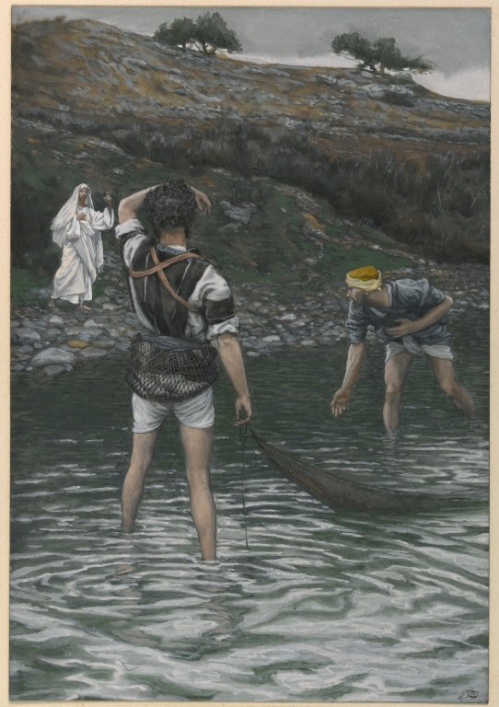
When Peter, Andrew, James and John – and later on, all the other disciples, left everything to follow Jesus, they did not know where he would be taking them…
The calling of Peter and Andrew by James Tissot, 19th century

Slide 3
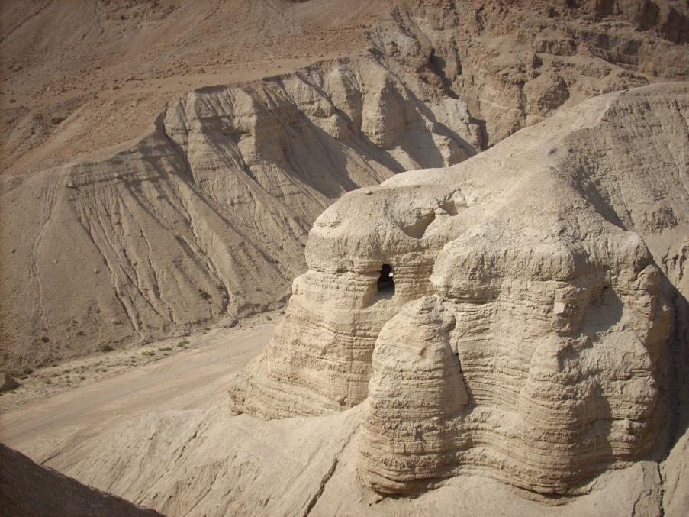

Slide 4
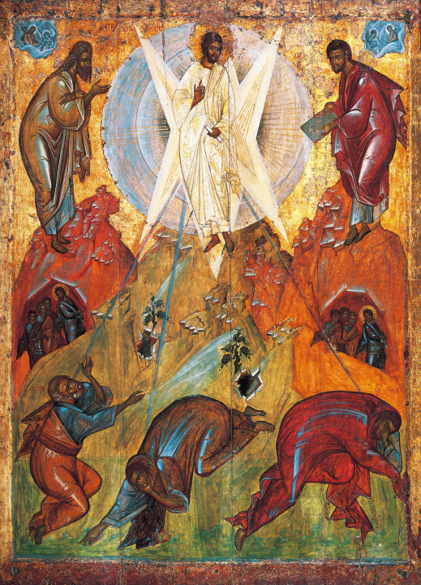
Theophanes the Greek, 15th century

Slide 5
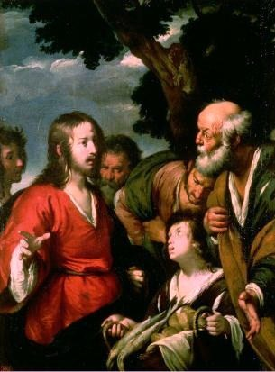
Feeding the multitudes by Bernardo Strozzi

Slide 6
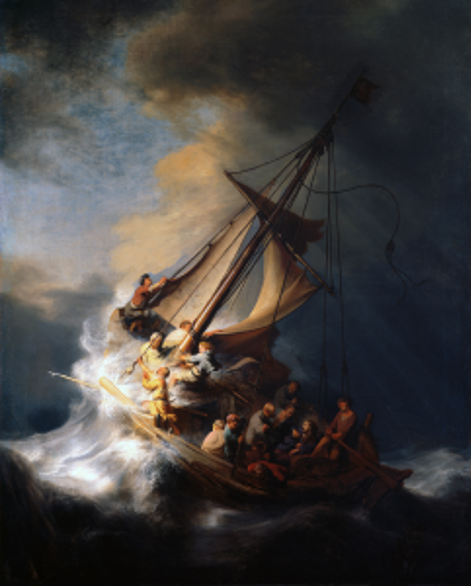
The Storm on the Sea of Galilee by Rembrandt

Slide 7
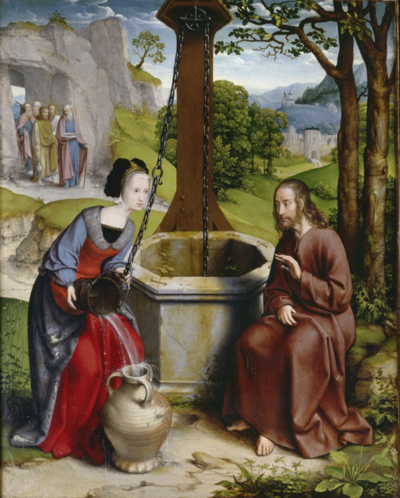
Christ and the Samaritan Woman, by Jan Joest van Kalkar

Slide 8
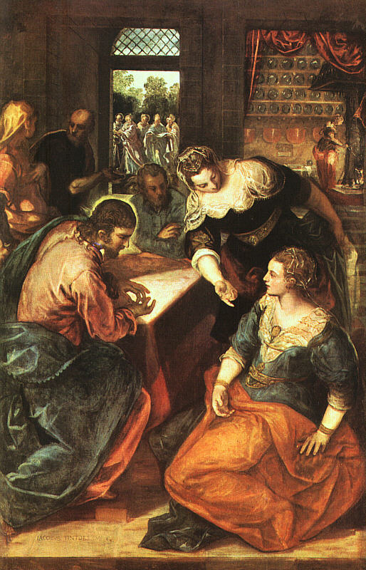
Jesus at the home of Martha and Mary by Tintoretto

Slide 9
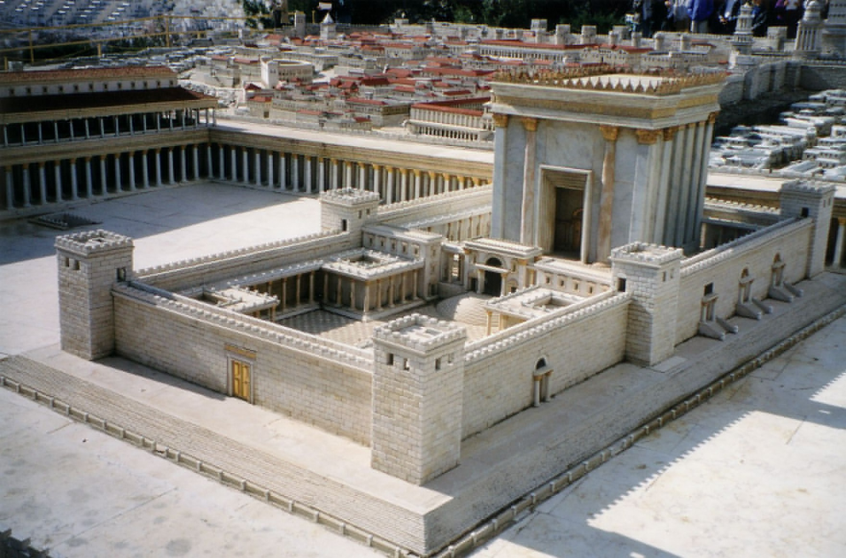
A model of the Second Temple, Israel Museum, Jerusalem. Juan R. Cuadra

Slide 10
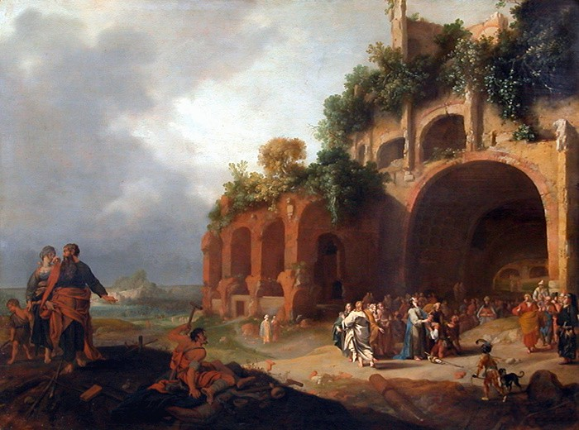
Jesus in Decapolis, Bartholomew Breen

Slide 11
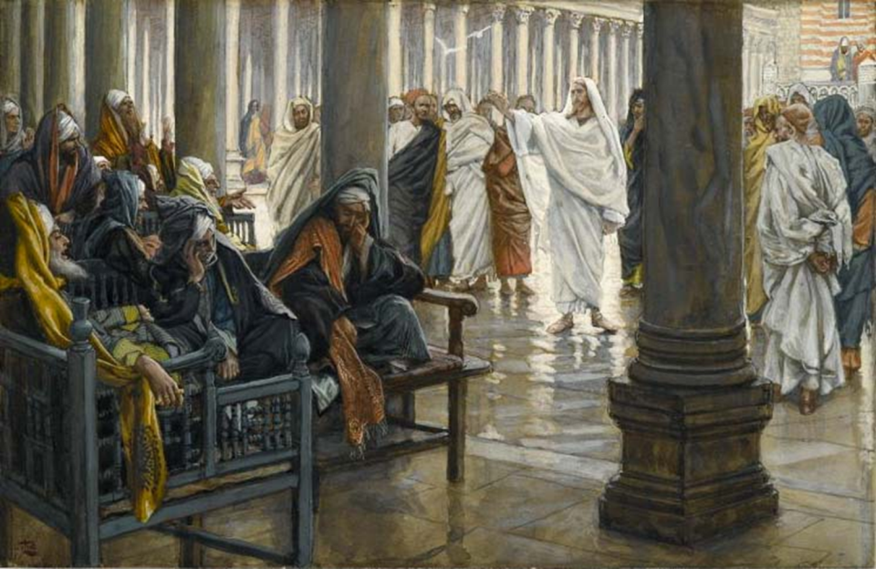
Jesus with the Pharisees in the Temple, James Tissot

Slide 12
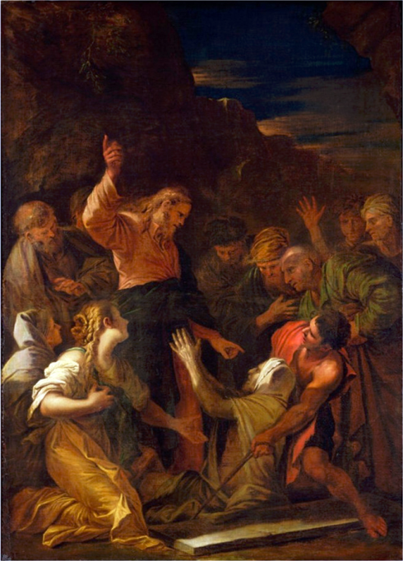
Christ cleansing a leper by Jean-Marie Melchior Doze

Slide 13
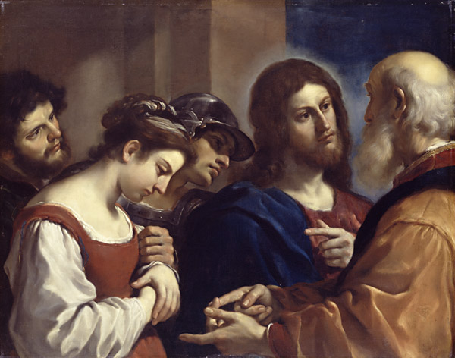
Christ with the Woman Taken in Adultery, by Guercino

Slide 14
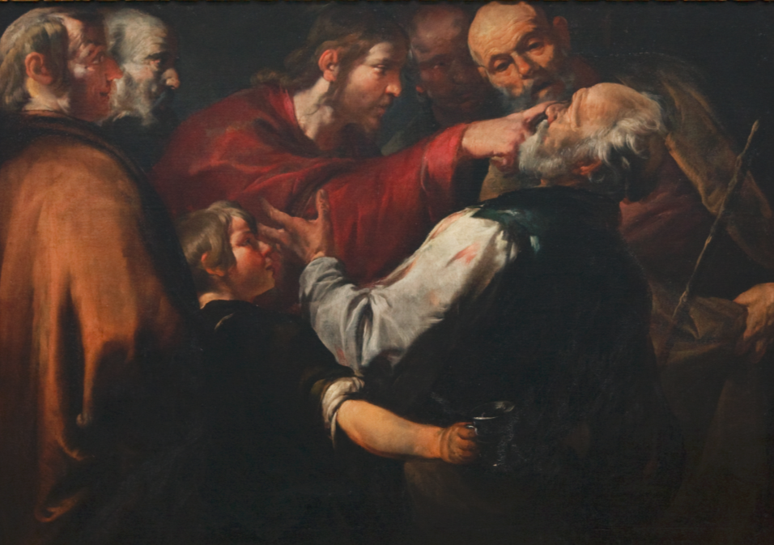
Christ Healing the Blind Man c 1640

Slide 15
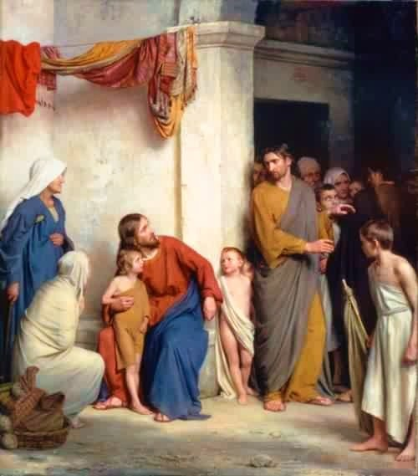
Christ with children by Carl Heinrich Bloch

Slide 16
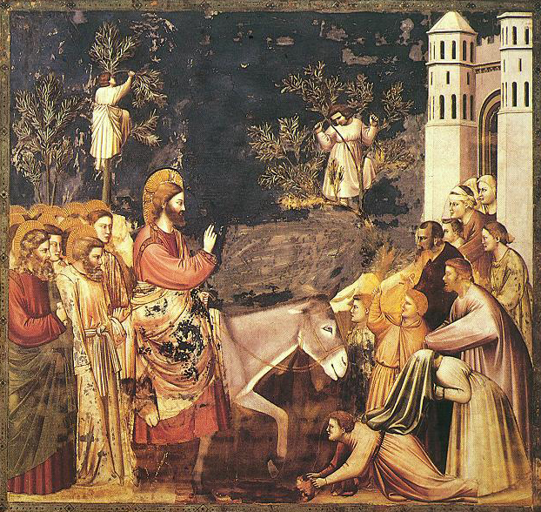
Jesus enters Jerusalem, by Giotto

Slide 17
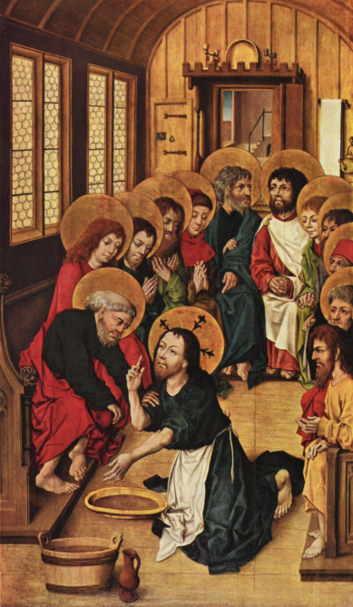
Christ Washing the Feet of the Apostles by Meister des Hausbuches, 1475

Slide 18
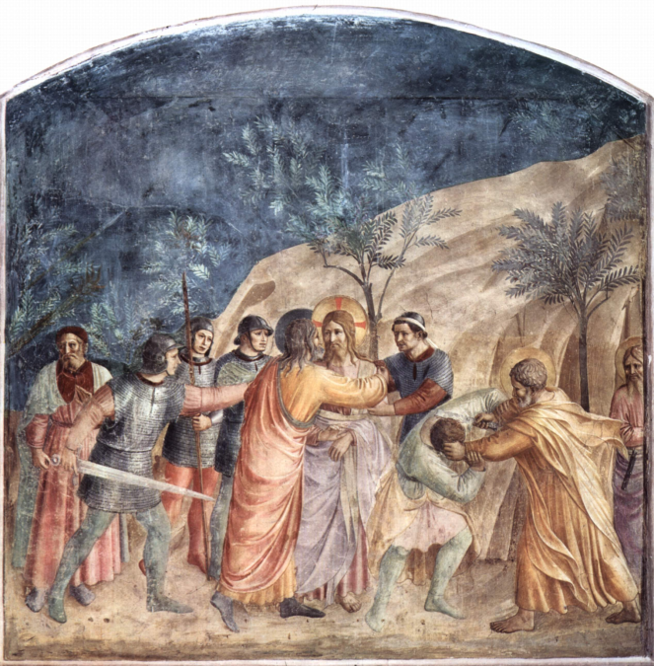
The Capture of Christ by Fra Angelico, c. 1440

Slide 19
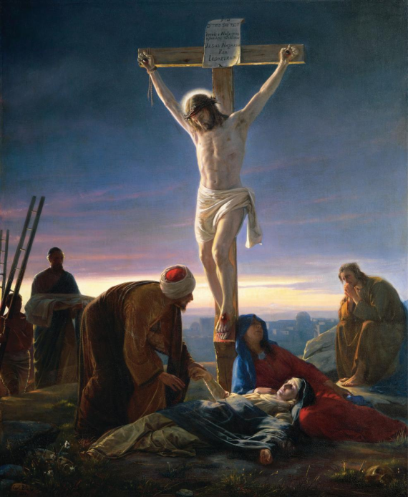
Christ on the Cross, by Carl Heinrich Bloch

Slide 20
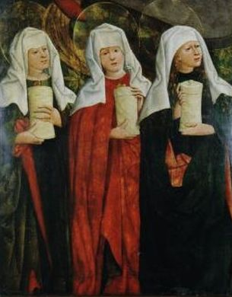
The Three Marys at the Tomb by Mikołaj Haberschrack, 15th century

Slide 21
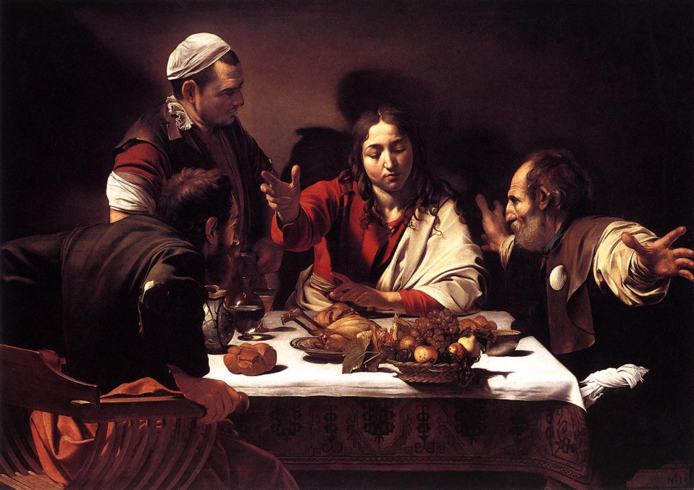
Supper at Emmaus, Caravaggio

Slide 22
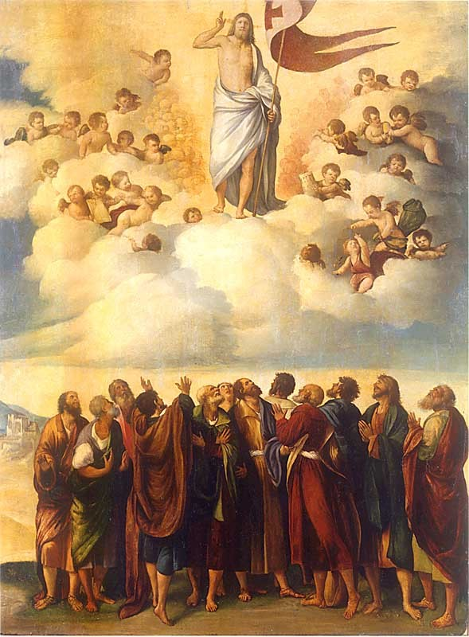
The Ascension, by Dosso Dossi, 16th century.

Slide 23
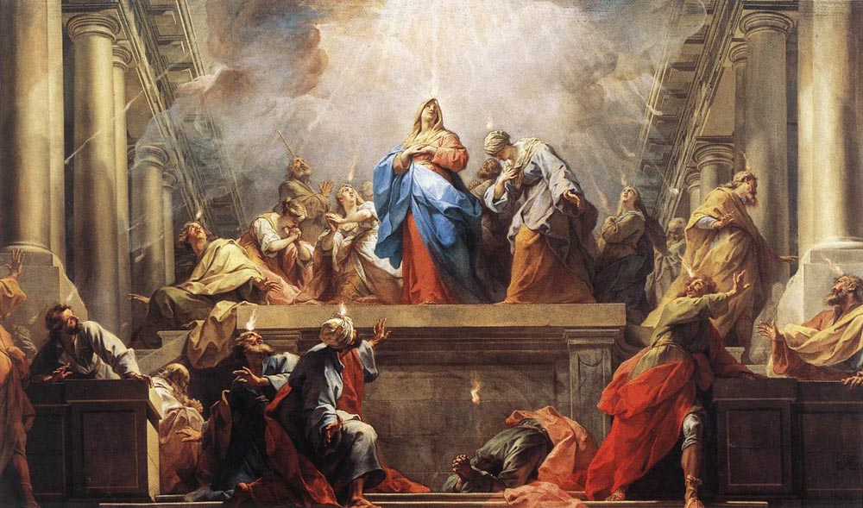
Pentecost, Jean II Restout, 1732

Slide 24
Preparing
the Way
Following Jesus
wherever he leads…

